Slide 1
Project Report For Sunrise Park Resort
Uma Maheshwari

Slide 2
Sunrise Park Resort details
Sunrise Park Resort is located in northwestern Montana.
The resort originally opened in 1947 with an annual snowfall of 333 inches and 3,000 acres of skier and rider accessible terrain.
Sunrise Park Resort offers access to 105 named trails and vast bowl and tree skiing.
The longest run is named Hellfire and is 3.3 miles in length.
The base elevation is 4,464 feet, and the summit is 6,817 feet with a vertical drop of 2,353 feet.
New Investment
Sunrise Park Resort has recently installed an additional chair lift to help increase the distribution of visitors across the mountain. This additional chair increases their operating costs by $1,540,000 this season.

Slide 3
Problem Statement
How much we can get a compensation for the operational cost by increasing the adult weekend ticket prices?
Is it possible to compensate the operational cost by increasing the weekend price?

Slide 4
Dataset characteristics and model used
Dataset features
we used a dataset consisting details of 330 resorts in US. This dataset includes the location, summit elevation, vertical drop, base elevation, average snowfall, weekend price.
Machine learning model
We built a linear regression model. Response variable of this model is price of adult tickets during the weekend. The model chosen to predict the AdultWeekend Price is using the follow columns from the dataset: vertical drop, trams, fast Eight, fast Sixes, fast quads, quad, triple, double, surface, total chairs, Runs, Terrain Parks, LongestRun mi, SkiableTerrain ac, Snow Making ac, daysOpenLastYear, yearsOpen, averageSnowfall, AdultWeekday, AdultWeekend, projectedDaysOpen, NightSkiing_ac, clusters.
Here prediction is done for Sunrise Park Resort adult weekend price column. The actual adult weekend price of the Sunrise Park Resort is 78 dollars. And the model predicted a value of 77.99 dollars. The explained variance of this model is 0.71. And the mean absolute error value is 6.50.

Slide 5
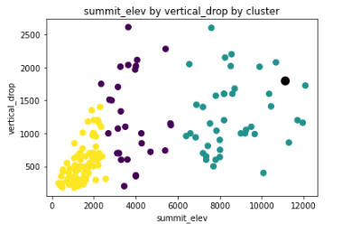
Here we can see that the resorts are clustered into three groups first one having small summit elevation and vertical drop, next one having the middle range and the third cluster having the large summit elevation and vertical drop. And the Sunrise Park resorts falls into the third category.

Slide 6
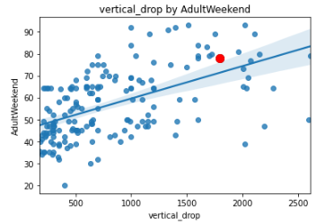
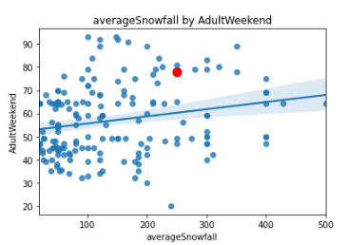
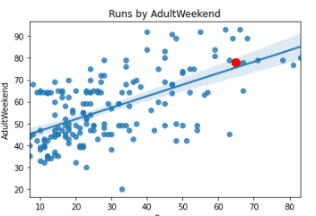
The price of adults during the weekend is only moderated explained by the features present in the dataset.

Slide 7
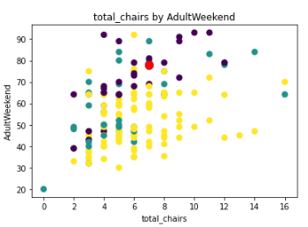
From the above scatter plot we can observe the increased adult weekend price with increase in the count of total chairs but when the total no of chairs is equal to 16 the adult weekend price is not higher it lies between 60 and 70 which is not the highest weekend price

Slide 8
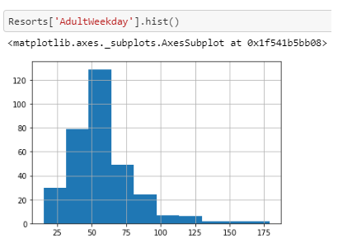
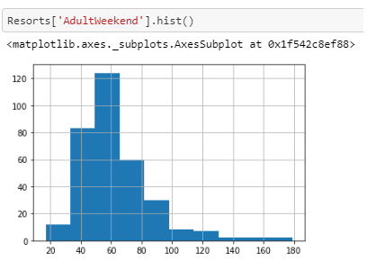
During weekdays: Most the resorts charge between 25– 175dollars. A small fraction charge prices up to aprox 125 dollars
During weekdays: Most the resorts charge between 25– 180dollars. Comparing to weekdays histogram a slight spread is observed in weekend price.

Slide 9
Summary
The variables present in the dataset moderately explain the outcome of the response variable (AdultWeekend).
Since this is an additional chair lift this will not attract more visitors. But an additional chair lift reduces the crowd and distribution of visitors over the mountain.
This increase in adult weekend price will not fully compensate the operational cost as we see there is less response between the features and the response variable.
Therefore, to compensate the investment in this equipment, resort should consider opportunities in decreasing the maintenance cost of the chair lifts.

